Slide 1
Go to College. Get Ahead!
Dual Credit Information Session
Student Orientation

Slide 2
Course Options for New Dimensions High School
Remember!!
It is important that the student choose a class that is within their intended college major and on the AA Evaluation
Prior to graduation, it is the student’s responsibility to request that the college transcript be sent from Valencia College to the university of their choice.
New Dimensions High School students can take DE courses at the high school.
This semester – English Comp II

Slide 3
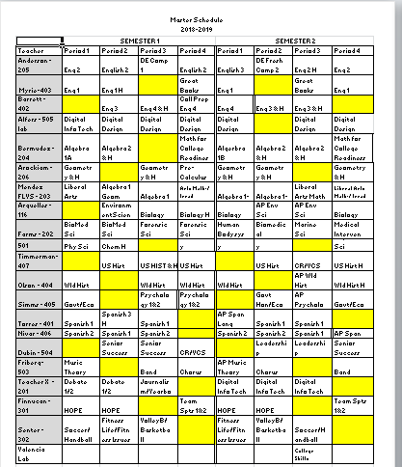
NDHS Master Schedule

Slide 4
Graduation Requirements
Economics with Financial Literacy
  Florida Virtual School
  New Dimensions High School
  World History
  Florida Virtual School
  New Dimensions High School
  American History
  Florida Virtual School
  New Dimensions High School
    Valencia College (AMH2010 & AMH2020)
  On-Line Requirement – by end of Fall Semester, Senior Year!
  Florida Virtual School
  New Dimensions High School
    Valencia College

Slide 5
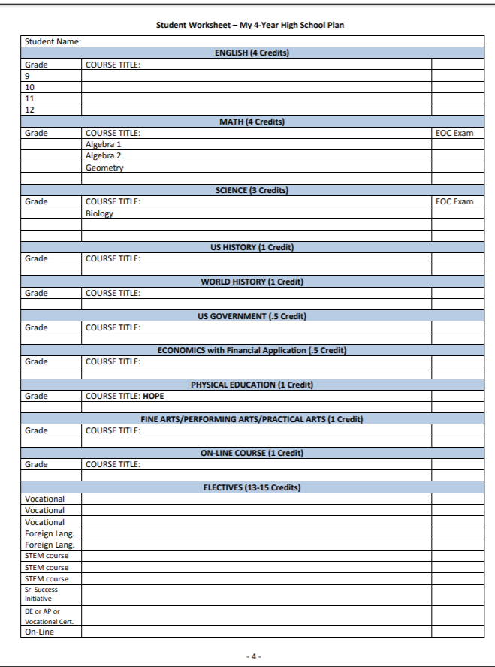
High School Graduation Requirements

Slide 6
Understanding Your Degree Plan
The Associate in Arts (A.A.) degree is designed for the student who plans to transfer to a Florida public university as a junior to complete a Bachelor’s degree.
Through the A.A. degree, Valencia offers lower division preparation for almost all of the approximately 200 majors in the State University System of Florida.
The A.A. degree provides the courses of study equivalent to those offered in the freshman and sophomore years (lower division) of Florida’s State Universities; a student who earns an A.A. degree from Valencia meets the lower division general education requirements of a Florida state university, but does not automatically meet the requirements for a particular major.
See Valencia’s web site for more information on degrees.

Slide 7
AA Degree Requirements = 60-62 college credits

Slide 8
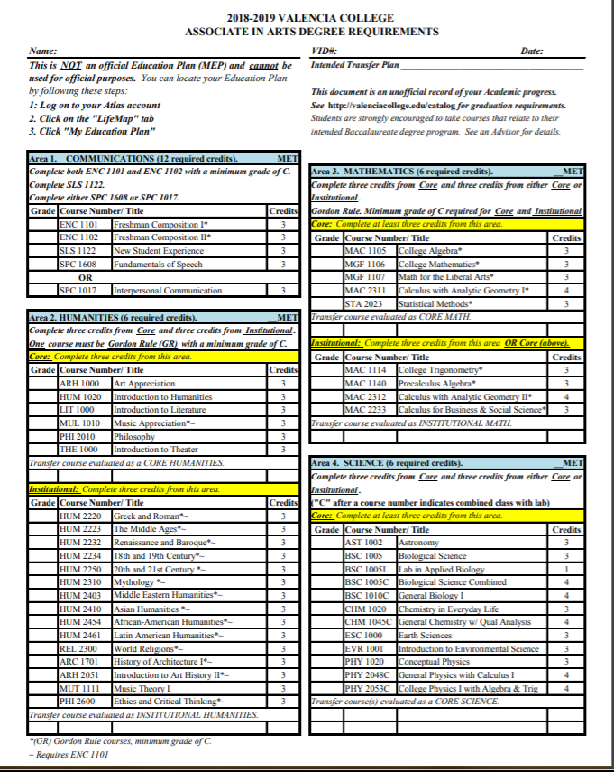
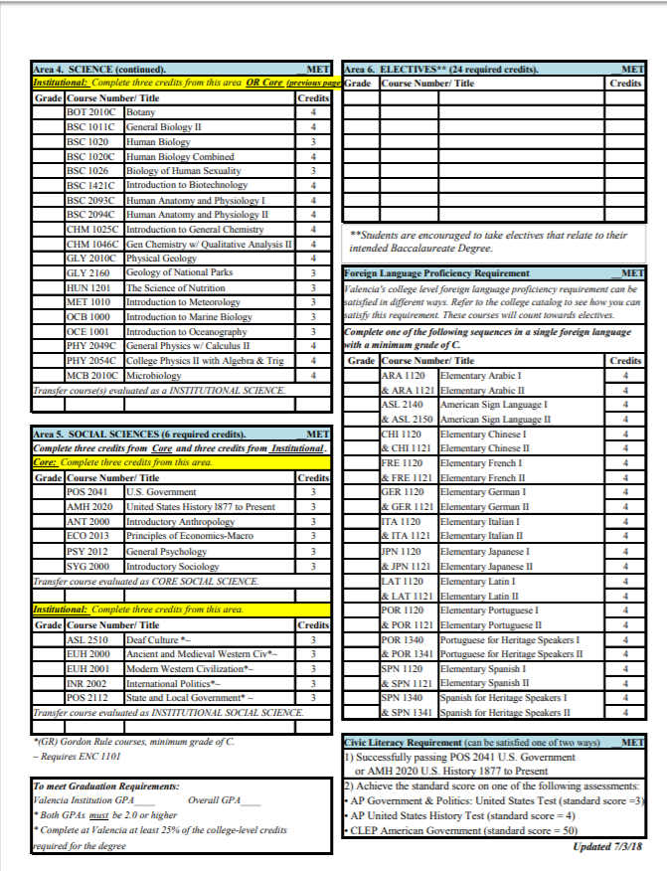

Slide 9
DE Students
Students will need to research their intended 4-yr college to make sure all courses transfer into degree plan. DE students will typically apply to college as FIRST-TIME FRESHMEN and must meet all freshmen admission requirements, including SAT/ACT scores.
Associates of Arts Degree
60-62 hours

Slide 10
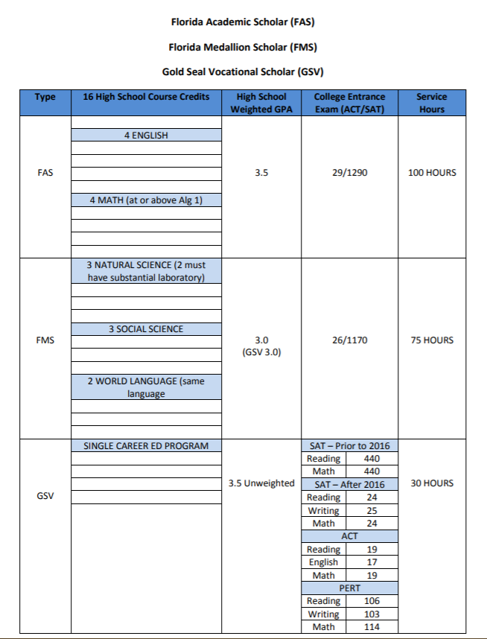
Bright Futures Requirements

Slide 11
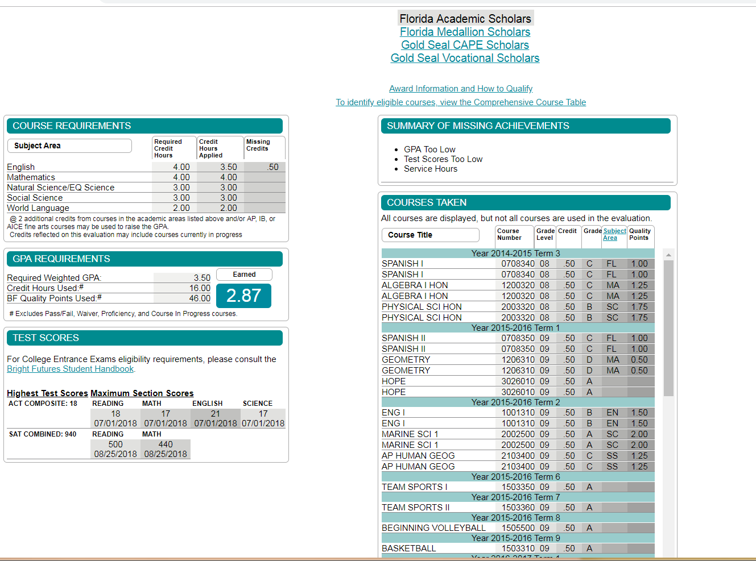
Actual BF Evaluation

Slide 12
DE Requirements
Incoming JUNIORS must complete Economics with Financial Literacy
Must successfully complete EOC & FSA requirements by end of sophomore year
PERT required – testing will be scheduled through VALENCIA
Application to Valencia College – completed on-line
Associates of Arts Degree
62 hours

Slide 13
CONSEQUENCES OF DROPPING A DUAL ENROLLMENT COURSE
Withdrawals remain on the college transcript (this deadline is established by Valencia College)
Drop Rule
Students who drop a dual enrollment course without the permission of NDHS administration are no longer allowed to participate.

Slide 14
Required to complete:
High School Graduation Check Sheet
AA Degree update
Print out Bright Futures Scholarship Evaluation
New Students – Complete and return DE contract
Print out DETAILED VC Schedule

Slide 15
How to print out Detailed VC Schedule
Log in to ATLAS account
Click “Courses” Tab (top left of screen)
Click “Registration” (on right of screen)
Click on drop down menu – (3rd from bottom)
“Student Detailed Schedule”
Select “Semester” for which you are registered
Print Schedule OR save as PDF
DO NOT SIGN UP FOR “FLEX” COURSES!
https://ValenciaCollege.edu/support/howto/

Slide 16
Communication:
All students must establish their Google Account
  Check Dual Enrollment Classroom - Mandatory
Activity Calendar
  Check Daily
  New Dimensions High School Email
  Check Daily (Google Account)
  John.Doe@newdimensionshs.com
  Phone Call-Outs
  FOCUS
  Florida Shines - https://www.floridashines.org
  NDHS Web Site - https://newdimensionshs.com/
  “Daily Dubin”

Slide 17
Complete DE Contract at This Time
Initial each paragraph - student
Student Signature
Parent Signature
Date
Student ID number
Phone Number
Deadline to return contract – November 26, 2018*
Deadline to Issue/Return books – December 17-18, 9:00am-3:00pm
DE Application for Fall 2019 Opens – Monday, February 25, 2019
DE Application for Fall 2019 Closes – Monday, March 25, 2018
Test Score Deadline – Monday, April, 15, 2019
*No books, vouchers, or appointments will be issued without signed contract

Slide 18
Questions?
Parent Orientation

