Slide 1



2025-2026
Title I Annual Meeting
New Dimensions High School
We are an “A” School

Slide 2
What is Title I?
Title I is the largest federal assistance program for the nation’s schools.
The goal of Title I is to provide supplemental funds to assist with closing the achievement gap.
The funds are disbursed from the federal government, to the State of Florida, and then to the Local Education Agency (LEA), which is the District.
The District follows the LEA plan for disbursement to the schools.
New Dimensions High School is a Title I school because more than 60% of the students meet poverty requirements.

Slide 3
What is the LEA Title I Plan?
The LEA Title I Plan is the District’s annual plan for district strategic initiatives to increase academic achievement.
The LEA Title I Parent and Family Engagement Plan is a component of this plan.
Some items included are:
Student academic assessments
Staff Qualifications and Professional Development
Parental Engagement Strategies, including the LEA Parent and Family Engagement Plan
School improvement goals
Title I parents/guardians have the right to be involved in the development of the LEA Title I Plan and the LEA Parent and Family Engagement Plan.

Slide 4
What is a School-Wide Title I Plan?
Each school receiving Title I funds must have a plan.
The school-wide plan components are included in the School Improvement Plan (SIP)
Title I parents/guardians have the right to be involved in the development of New Dimensions High School’s Improvement Plan (SIP)

Slide 5
School Improvement Planning
Our school has identified the following areas of focus for 2025-2026:
1. Mathematics
2. Reading
During the months of September, December, and March, we will review, discuss, and solicit feedback regarding the school’s Title I and Parent & Family Engagement plans.

Slide 6
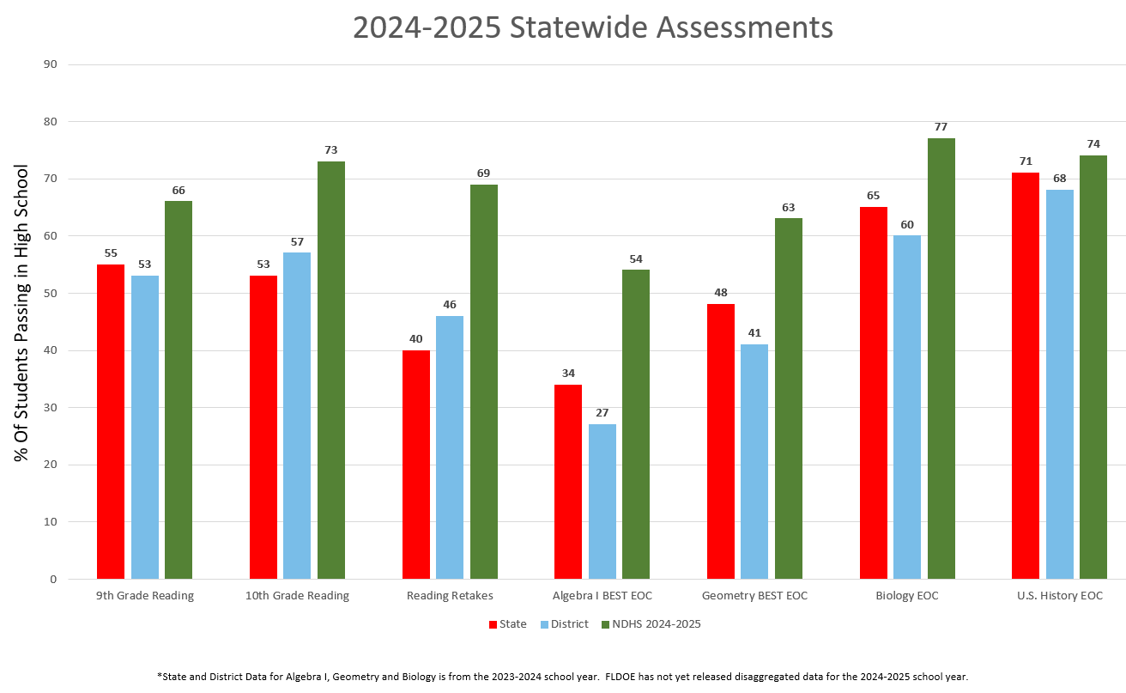
School Improvement Plan Scores
Student scores for the 2024-2025 Florida Standards Assessment (FSA)
and/or End-of-Course (EOC) are listed below:
Insert data from your school’s 2024-2025 test administration here
Insert data from your school’s 2024-2025 test administration here
Insert data from your school’s 2024-2025 test administration here
Our school’s 2025-2026 School Improvement Plan can be accessed at:
https://www.floridacims.org/districts/osceola
Each school year, we use the previous year’s scores to determine our school improvement goals for the next year.

Slide 7
How does School Name use Title I and SIP funds?
Federal Title I funds must supplement the school’s existing programs. At our school we use Title I funds to:
Add paraprofessionals to the classroom
Purchase supplemental software and technology equipment
Conduct parental educational meetings/trainings/activities

Slide 8
What is the 1% set-aside and how are parents involved?
For the 2025-2026 school year, the Title I allocation for The School District of Osceola County is $20,449,313.00 Federal law requires the LEA to set aside 1% for parent and family engagement.
90% of the 1% amount must be allocated to all District Title I schools to implement school-level parent and family engagement. Our school received $1,424.21
The School District of Osceola County (LEA), will use the remaining 10% of the 1% for parent and family engagement, as well as parent and family events and training.
Title I parents/guardians have the right and are encouraged to be involved in how this money is spent at the LEA and school level.

Slide 9
What is the Parent and Family Engagement Plan?
The LEA and each Title I school creates a Parent and Family Engagement Plan (PFEP)
This PFEP explains how the requirements of the Every Student Succeeds Act of 2015 (ESSA) will be implemented at both the District and School levels.
It includes:
Expectations for parents
How parents will be involved in decision-making
How the LEA and schools will work to build the schools’ and parents’ capacity for strong parent and family engagement to improve student academic achievement
Title I parents/guardians have the right to be involved in the development of the School and District Parent and Family Engagement plans.

Slide 10
Input on spending Title I Parent Engagement Funds
To use funds for Parent Engagement, schools must meet the following criteria:
1. Educate the parents on Title I
2. Ensure funds are aligned towards academic achievement
(Language Arts, Math or Science)
3. Have educational interaction between the parent and student
Please provide suggestions on utilizing Title I Parent and Family Engagement funds at our school.

Slide 11
How is the evaluation of the
Parent and Family Engagement Plan conducted?
Evaluation Requirements
Annual evaluations with Title I parents/guardians
Parent/guardian surveys (required)
Focus groups
Parent Advisory Committees
Analyze content and effectiveness of the current plan
Identify barriers to parental involvement
Data/Input may include:
Process and timeline
How the evaluation helps create next year’s plan

Slide 12
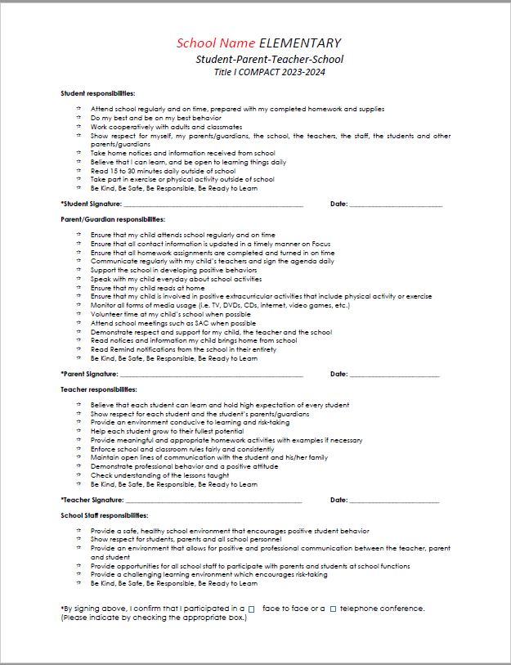
What is the School-Parent Compact?
The Compact is a commitment from the school, the parent, and the student to share in the responsibility for improved academic achievement.
Title I parents/guardians have a right to be involved in the development of the School-Parent Compact.

Slide 13
What are the Standards my child is expected to achieve?
State of Florida adopted the ELA Florida’s B.E.S.T. Standards K-12 and Mathematics Florida Standards
The Mathematics B.E.S.T. standards provide clear educational standards while allowing local districts and schools the flexibility needed to deliver quality instruction in the classroom.
The standards (which are not to be confused with curriculum or instruction) are designed to ensure all students, regardless of demographics, graduate high school prepared to enter college or the workforce.
The standards are internationally benchmarked and provide our students with an edge in the global jobs market by ensuring mastery of knowledge and skills needed to perform today's high-skill, high-wage occupations.

Slide 14
What is my child learning?
SUBJECT | PUBLISHER | TEXTBOOK
Reading | McGraw Hill | Florida Wonders 2023 Edition
Math | McGraw Hill | Florida Reveal Math 2023 /1st Edition
Social Studies | McGraw Hill | Florida Networks Social Studies 2018 Edition
Science | Pearson / Savvas | Savvas Elevate Discovery Experience (supplemental)

Slide 15
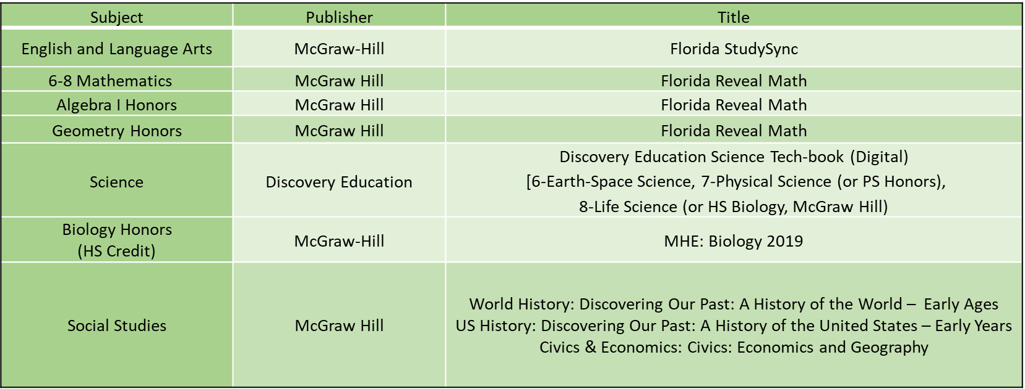
What is my child learning?

Slide 16
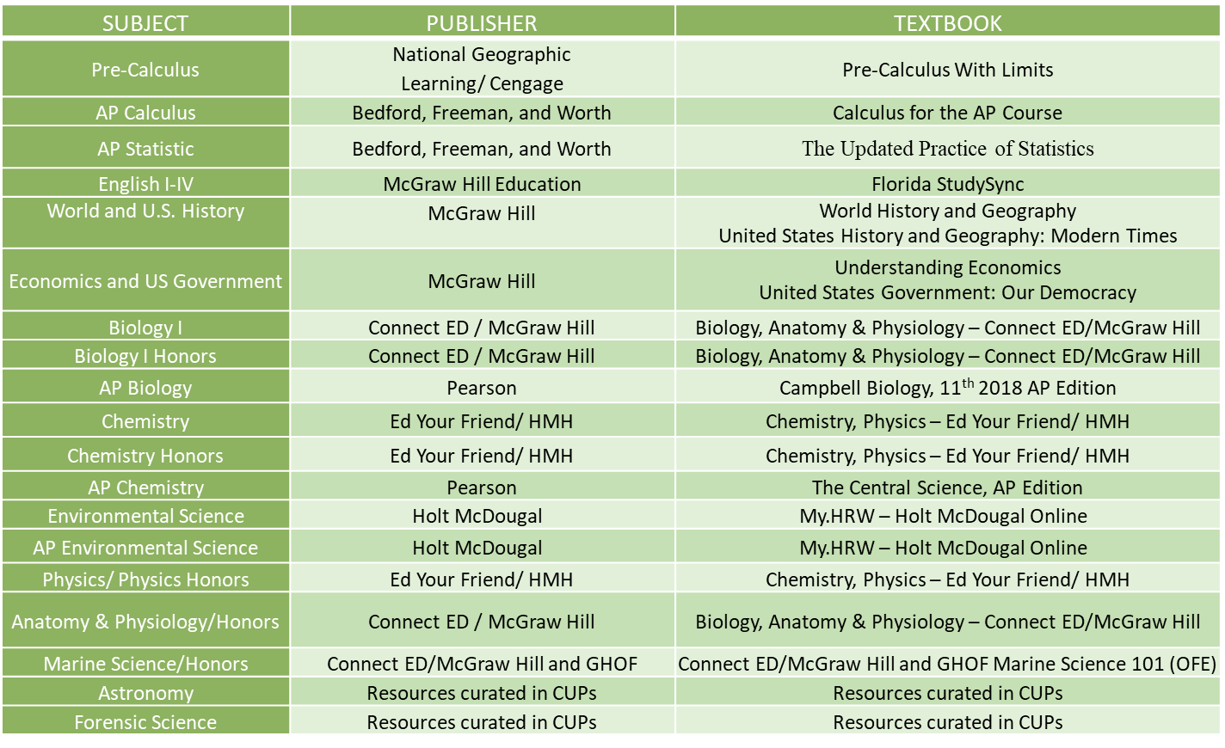
What is my child learning?

Slide 17
How is the school evaluating my child’s achievement?
Entry/exit placement tests for English as a Second Language (ESOL)
FL Kindergarten Readiness Screener (FLKRS) Elementary
FAST Reading Progress Monitoring (Grades K-10)
FAST Mathematics Monitoring (Grades K-8)
Reading Assessments: NSGRA – K-5, NWEA Oral Fluency K-5
BEST/NGSSS End of Course Assessment (Algebra, Geometry, Biology, U.S. History and Civics)
Statewide Science Assessment on Florida’s Academic Standard in Science (Grades 5 & 8)
End of year assessments for all courses (Grades 9-12)
Florida Standards Assessments (Grades 3-10)
Stanford Achievement Test (SAT10) Grade 3 only
End of Course (EOC) Assessments for Algebra I and Geometry.

Slide 18
How do I request the qualifications of my child’s teachers?
Title I parents/guardians have the right to request the qualifications of their child’s teachers.
The Title I Information booklet explains parents’ rights.
To request qualifications:
Request from the principal in writing
Access the information at: https://www.fldoe.org/teaching/certification/index.stml
Every Student Succeeds Act (ESSA). Our school presently has 17 or 77 % of state certified teachers
5 teachers who are teaching “out of field”
Information is sent home monthly
Four Week Notice

Slide 19
What are my rights as a Title I Parent/Guardian?
You have the right to know:
An opportunity to schedule regular meetings to make suggestions and participate, as appropriate, in decisions that relate to your child's education
Expect a response to any suggestions in a timely manner
Submit comments on the school-wide plan as soon as it is available to the LEA, if you do not believe it to be satisfactory
Be involved in how funds are allocated and spent at the LEA and school level
Be involved in the development of the LEA and School Title I Plans
Be involved in the development and review of the School and District Parent and Family Engagement Plans (PFEP)
Be involved in the development of the school-parent compact
Be involved in the development of the School Improvement Plan (SIP)
Request the qualifications of your child’s teachers

Slide 20
How can parents become involved?
School Level
Attend school events
Volunteer
Participate in Parent-Teacher Conferences
Communicate with School Staff
Follow Social Media
District Level
Attend School Board Meetings
Provide feedback through surveys
Engage in communications
Follow district social media

Slide 21
Who are my Title I contacts at the school?
Name | Phone | E-mail address
Mr. Alfers | 407-870-9949 | alfers@newdimensionshs.com
Mr. Mezzina | 407-870-9949 | mezzina@newdimensionshs.com
Website – newdimensionshs.com
For additional information please visit our website: https://www.osceolaschools.net/Domain/160

Slide 22

We’re here to make good things happen for other people.
Any questions?

